Slide 1
Activity Diagram
Object Oriented Development
with Java
(CT038-3-2 and Version VC1)
System Modeling

Slide 2
Topic & Structure of The Lesson
Activity diagram

Slide 3
Learning outcome
At the end of this lesson, you will be able to:
Model a system using an activity diagram

Slide 4
Key terms you must be able to use
If you have mastered this topic, you should be able to use the following terms correctly in your assessments:
-activity diagram(symbols and connectors)

Slide 5
Activity Diagram
Activity diagrams show a procedure or workflow
used in process modeling and analysis during requirements engineering
show a sequence of activities with alternate paths, and/or parallel paths

Slide 6
Activity Diagram
Used for:
documenting existing process
analyzing new Process Concepts
finding reengineering opportunities
The diagrams describe the state of activities by showing the sequence of activities performed
they can show activities that are conditional or parallel

Slide 7
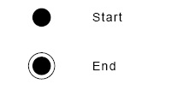
Activity Diagram Concepts
An activity is trigged by one or more events. An activity may result in one or more events that may trigger other activities or processes.
Events start from start symbol and end with finish marker and have activities in between that are connected by events.
The activity diagram represents the decisions, iterations and parallel/random behavior of the processing.
They capture actions performed.
They stress on work performed in operations (methods).

Slide 8
Activity Diagram
After you have created the Use Cases, you can use Activity Diagrams to graphically show the activities or workflows within the Use Cases
You can use this to provide a graphical view that compliments the Use Case scenarios
There is one Activity Diagram for each use case

Slide 9
Activity Diagram
Activity diagrams include the following elements:
Activities
Decision
Split of control
Merge of control
Iteration
Object flow
Swimlanes

Slide 10

Components
An activity is an ongoing, though interruptible, execution of a step in a workflow (such as an operation or transaction)
Represented with a rounded rectangle
Text in the activity box should represent an activity (verb phrase in present tense)

Slide 11

Components
An event is triggered by an activity. It specifies a significant occurrence that has a location in time and space.
An instance of an event (trigger) results in the flow from one activity to another.
These are represented by directed straight lines emerging from triggering activity and ending at activity to be triggered. Label text for events should represent event but not the data involved.

Slide 12
Components
A decision may be shown by labeling multiple output transitions of an activity with different guard conditions.
For convenience a stereotype is provided for a decision: the traditional diamond shape, with one or more incoming arrows and with two or more outgoing arrows, each labeled by a distinct guard condition with no event trigger.

Slide 13
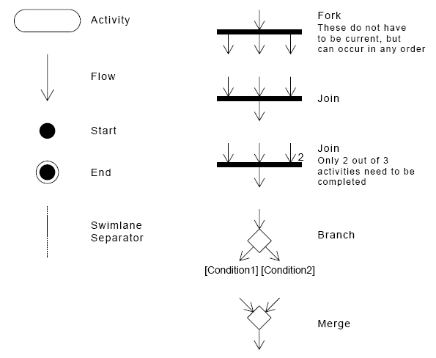
Activity Diagram Notation

Slide 14

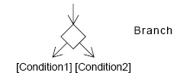
Interpreting an Activity Diagram
Diagrams are read from top to bottom and have branches and forks to describe conditions and parallel activities.
A fork is used when multiple activities occur at the same time.
A branch describes what activities will take place based on a set of conditions.

Slide 15

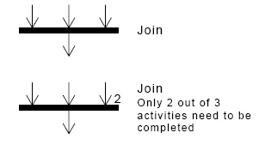
Interpreting an Activity Diagram
Diagrams are read from top to bottom and have branches and forks to describe conditions and parallel activities.
All branches at some point are followed by a merge to indicate the end of the conditional behaviour started by that branch.
After the merge all of the parallel activities must be combined by a join before transitioning into the final activity state.

Slide 16
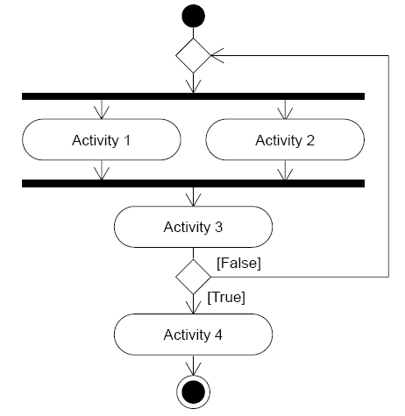
Example of a generic Activity Diagram

Slide 17
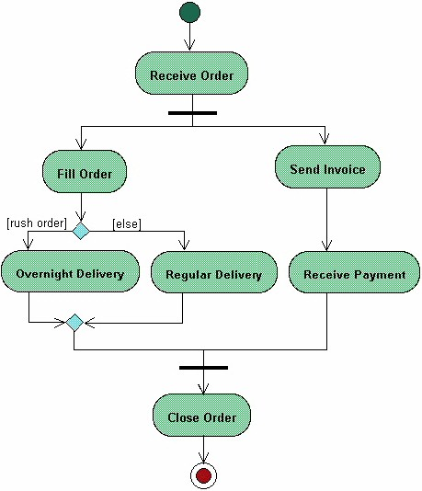
Activity Diagram Example
Start State
Activity
Fork
Branch
Merge
Join
End State

Slide 18
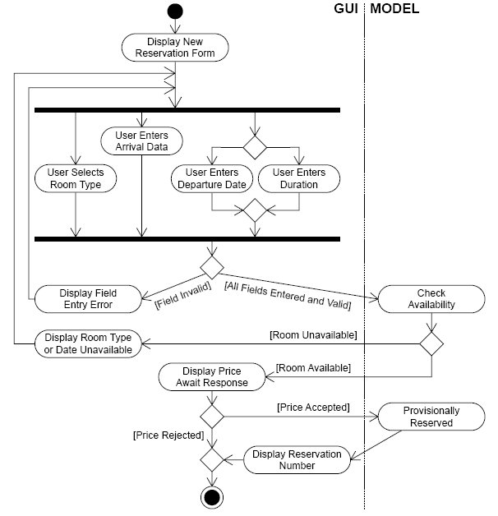
Activity Diagram for a New Reservation Use Case

Slide 19
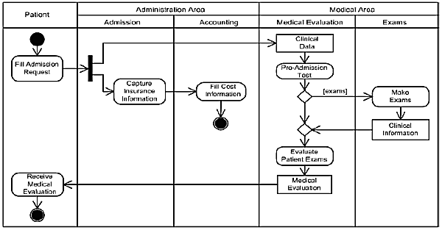
Activity Diagram for Admission of Patients

Slide 20
Steps to Create an Activity Diagram
Select a use case
Add activities to the diagram
Add flows
Add conditions, if necessary
Add synchronization bars, if necessary

Slide 21
Activity Diagrams in the Design Phase
Activity diagrams are not used often in the Design phase. They tend to be used when they can highlight features that the other dynamic view cannot show
As the name suggests, they are useful for:
Emphasizing activities
Showing parallel behavior

Slide 22
Activity Diagrams in the Design Phase
Activity diagrams can be drawn or redrawn if needed to support activities that are new or changed by the impact of design
You can add detail, add, or change swimlanes
For example, you could put the GUI, event handlers, and data persistence objects into a swimlane

Slide 23
When to Use Activity Diagrams
The main reason to use activity diagrams is to model the workflow behind the system being designed
Activity Diagrams are also useful for:
analyzing a use case by describing what actions need to take place and when they should occur
describing a complicated sequential algorithm
modeling applications with parallel processes
Activity Diagrams should not take the place of interaction diagrams and state diagrams
Activity diagrams do not give detail about how objects behave or how objects collaborate

Slide 24
Use Case
Withdraw money from a bank account through an ATM

Slide 25
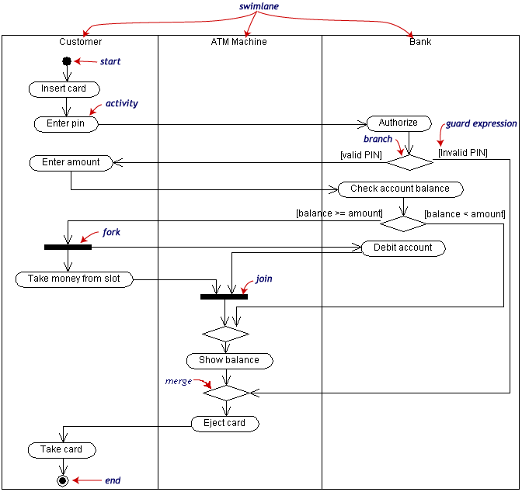

Slide 26
Disadvantage
A disadvantage of activity diagrams is that they do not explicitly present which objects execute which activities, and the way that the messaging works between them
Labeling of each activity with the responsible object can be done
It is useful to draw an activity diagram early in the modeling of a process, to help understand the overall process
Then interaction diagrams can be used to help you allocate activities to classes.

Slide 27
Quick Review Questions
What is an activity diagram?
What are the components of an activity diagram?
Draw the activity diagram for borrowing a book from the library

Slide 28
Summary of Main Teaching Points
-Activity diagram and its components

Slide 29
Q & A

